Slide 1
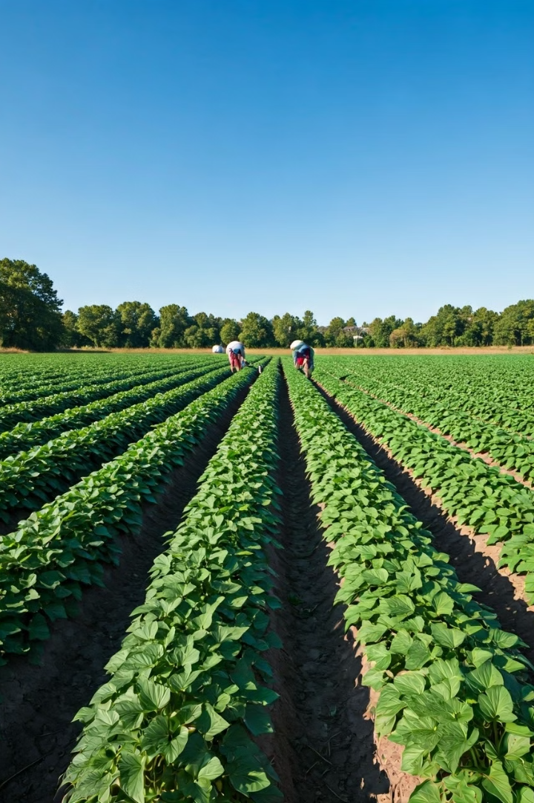

Transforming Lives Through Sweet Potato Farming in Migori, Kenya
I propose to lease land in Migori, Kenya and utilize it for cultivating sweet potatoes. This endeavor aims to address poverty and food insecurity in the region by allocating the farm's produce strategically.
by Kevien Otieno

Slide 2
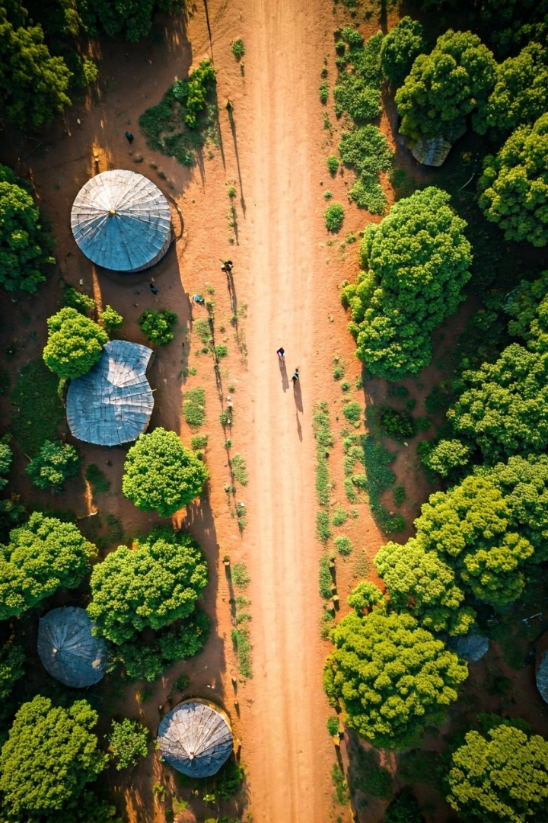
The Problem: Poverty and Food Insecurity in Kenya
1
Widespread Poverty
2
Food Shortages
Droughts, limited arable land, and lack of resources contribute to chronic food insecurity in parts of Kenya.
Many Kenyans, especially in rural areas, live below the poverty line, lacking access to basic necessities.
3
Vulnerability to Hunger
Impoverished communities in regions like Turkana are particularly susceptible to malnutrition and starvation.

Slide 3
My Solution: Farming Sweet Potatoes in Migori
Ideal Climate
Proven Crop
Community Engagement
Migori's warm, tropical climate and well-drained soils are perfectly suited for sweet potato cultivation.
Sweet potatoes are a hardy, nutritious, and high-yielding crop that can thrive in this region.
Local farmers will be employed and trained to participate in the farming operations.

Slide 4
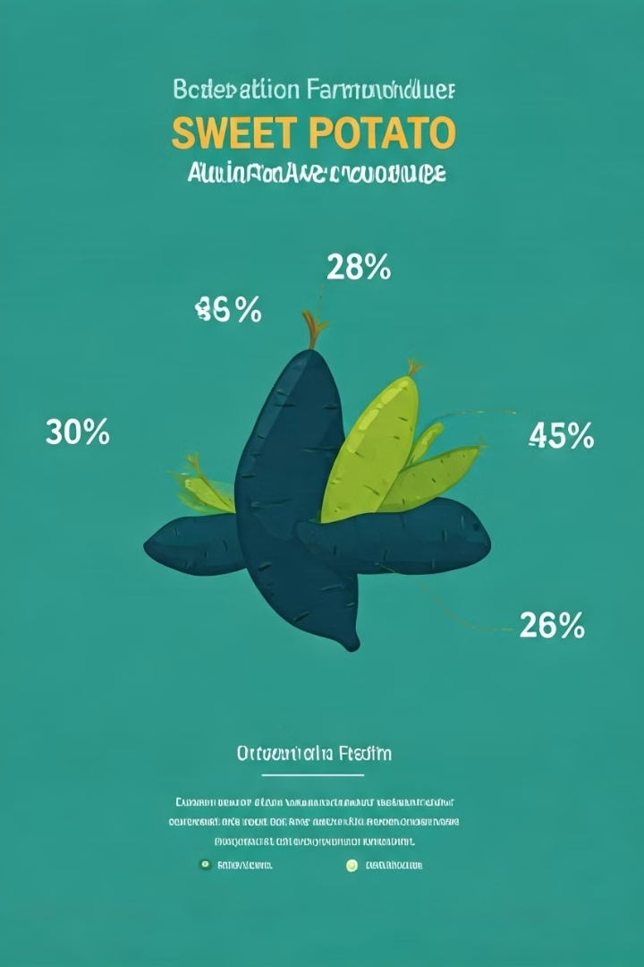
Allocation of the Farm Produce
60% to Support the Poor
30% to Generate Profits
A significant portion of the harvest will be distributed to impoverished communities, providing much-needed food assistance.
The remaining produce will be sold to generate revenue, enabling the sustainability and growth of the farming operation.
10% to Save for Future
A portion of the profits will be set aside to eventually purchase our own farmland, ensuring long-term viability.

Slide 5
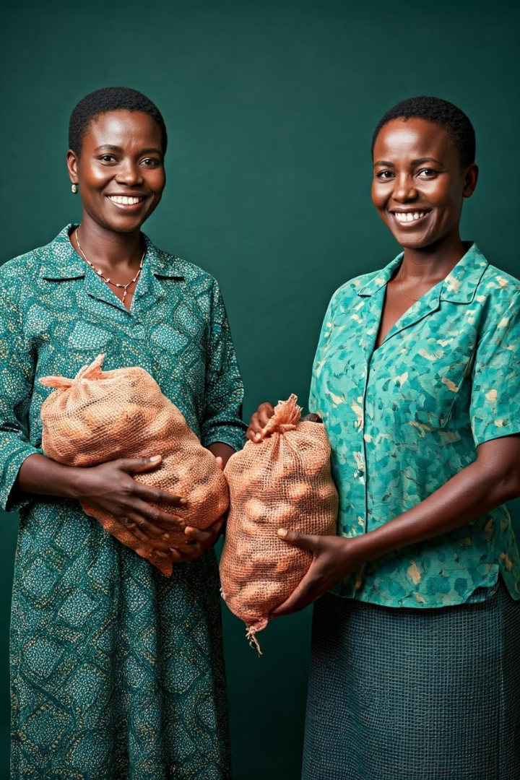
Potential Impact on the Community
1
Food Security
Providing steady access to nutritious sweet potatoes will alleviate hunger and malnutrition in targeted communities.
2
Economic Empowerment
Employment opportunities and income generation from the farm will help lift families out of poverty.
3
Community Resilience
The sustainable farming model will foster long-term stability and self-sufficiency in the region.

Slide 6
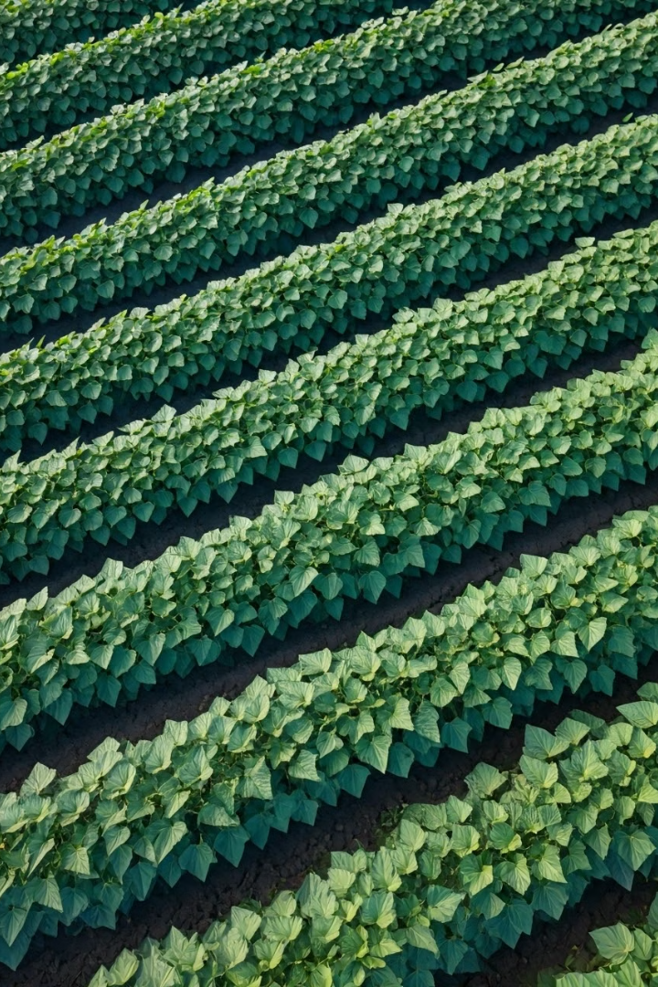




Competitive Advantage and Sustainability
Ideal Climate
Proven Crop
Migori's tropical environment provides optimal growing conditions for sweet potatoes.
Sweet potatoes are a well-studied, high-yielding, and nutritious crop choice.
Community Engagement
Scalable Model
The farming operations can be expanded to increase production and impact over time.
Collaborating with local farmers ensures community ownership and long-term sustainability.

Slide 7

Financial Projections and Funding Requirements
Initial Capital Investment
$50,000
Annual Operating Expenses
$30,000
Projected Annual Revenue
$75,000
Projected Annual Profit
$45,000
To launch this initiative, we require an initial capital investment of $50,000. With robust financial projections and a sustainable business model, we are poised to make a meaningful impact while generating profits to reinvest in the farm's growth.

Slide 8





The Path Forward
Secure Land Lease
Negotiate and finalize the lease agreement for farmland in Migori, Kenya.
Establish Operations
Hire and train local farmers, procure equipment, and begin sweet potato cultivation.
Distribute Produce
Allocate the harvested sweet potatoes according to the planned distribution model.
Reinvest and Expand
Utilize profits to acquire our own farmland and scale the operations for greater impact.

Slide 9


Join Us in Transforming Lives
By supporting this sweet potato farming initiative in Migori, Kenya, you can help us address poverty, improve food security, and empower local communities. Together, we can create a sustainable and scalable model that uplifts lives and drives lasting change.

